Slide 1




Thrust 3
Multiple Extremes: General Introduction
Maik Lang, University of Tennessee, mlang2@utk.edu
Elif Ertekin, University of Illinois Urbana-Champaign, ertekin@illinois.edu
Stewardship Science
Academic Alliances
Center Review Meeting
April 15, 2026

Slide 2




Thrust 3: Multiple Extremes – Outline
Maik Lang/Elif Ertekin – General Introduction of Coupled Extremes
John Hirtz – Radiation Experiments and Defect Characterization
Grady Clopton – Modeling of Ion Track Formation in CeO₂ with MD
Amir Movaffagh – Ab initio Modeling of Uranium Carbides and Nitrides
Sara Kadkhodaei – DEF Approach for Defect Phase Diagrams for SHI
Lowell Miyagi – Impact of Defect Structure on Material Behavior at Extremes
Steve Jacobsen – Influence of Defect Structure on Elastic Response
Maik Lang/Elif Ertekin – Facilities, Technique Development and Next Steps
2

Slide 3
III. MULTIPLE EXTREMES
Thrust 3: Multiple Extremes
Goal: To advance our knowledge of the behavior of materials exposed to multiple extreme environments, including intense particle and electromagnetic fields, to enhance material performance and to create new materials.
Modeling – Ion irradiation – Dynamic fragmentation
High-pressure and physical properties
X-ray irradiation and general characterization
3

Slide 4
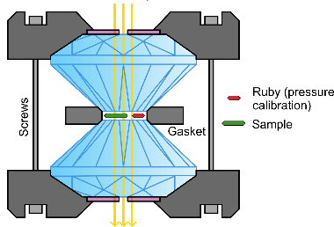
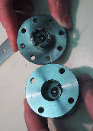
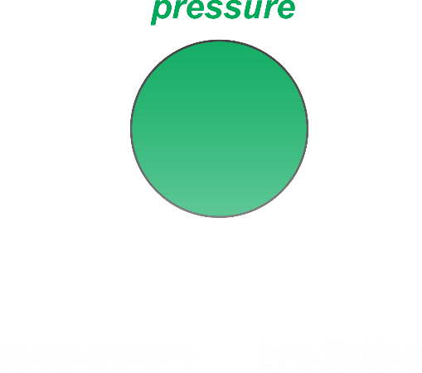
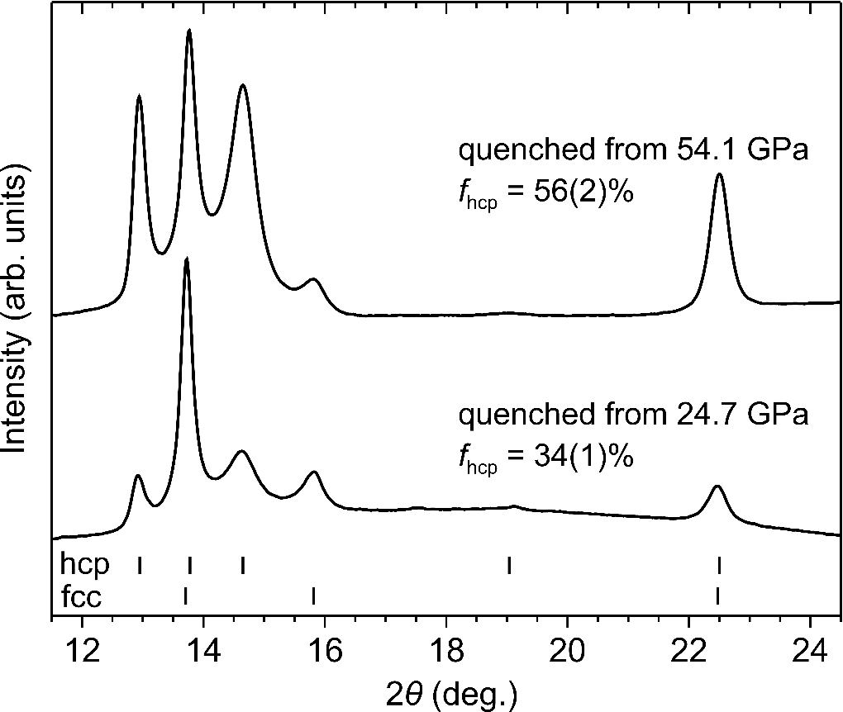
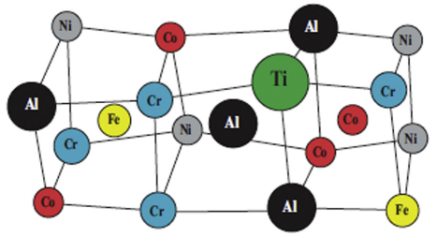
III. MULTIPLE EXTREMES
DAC Experiments: Pressure Extremes
High-Pressure Cell P ~ 1 Mbar
DAC experiments
High pressure synthesis of
hcp CrMnFeCoNi alloy
C. Tracy, et al.,
Nature Communications (2017)
(CDAC support)
4

Slide 5
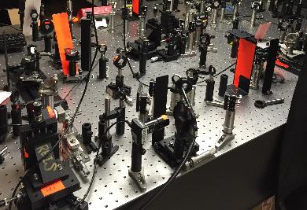
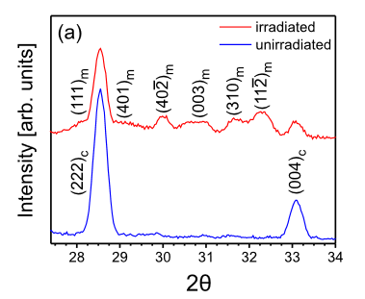
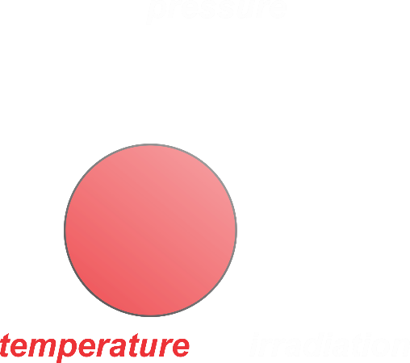
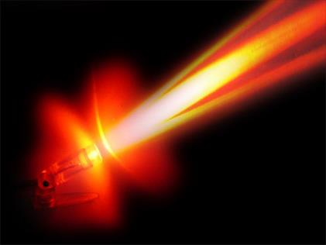
III. MULTIPLE EXTREMES
High-Temperature Extremes
Intense
Laser Pulses
40 J/cm²
Ultrafast laser experiments
Phase transitions in ZrO₂ from
intense electronic excitations
D.R. Rittman, et al.,
Applied Physics Letters (2015)
(CDAC supported beamtime)
from: www.sunbeamtech.com
5

Slide 6
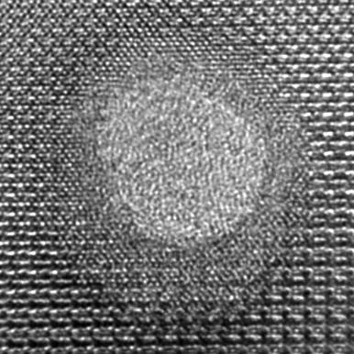
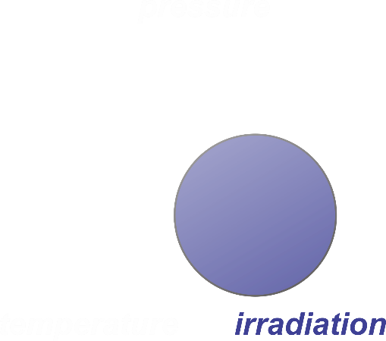
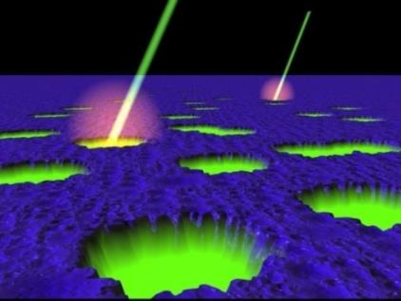
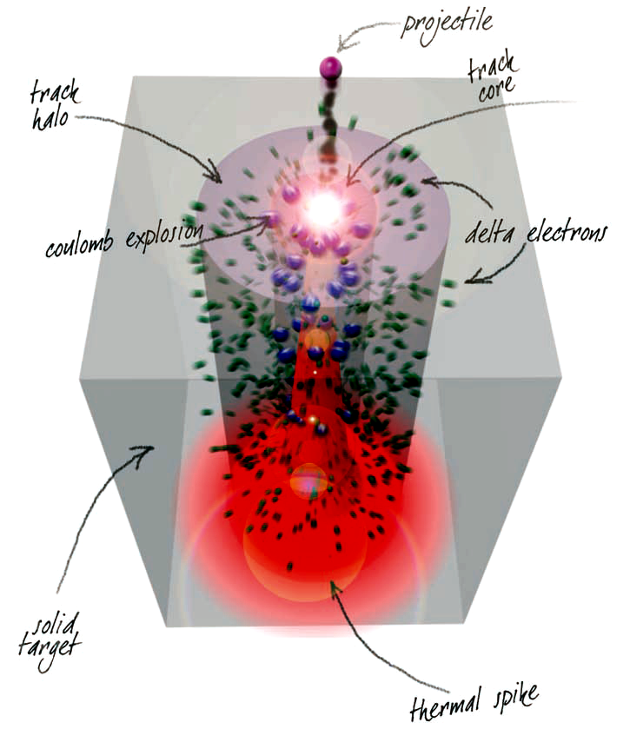
Swift Heavy Ions: Extremely Ionizing Radiation
III. MULTIPLE EXTREMES
Advanced Radiation Facility
Multiple transient extremes within ion tracks
Generated by Heavy Ion Accelerators
Products from Actinide Fissioning
T,P
Galactic Cosmic Rays
946 MeV ¹⁹⁷Au ions
Transient energy depositions (~10 eV/atomic bond)
Intense electronic excitations and extreme ionizations
Thermal spike with picosecond quenching (~10,000 K)
Formation of dynamic pressure wave (several GPa)
from: www.simsworkshop.org
Ion Irradiation ρ_{E} ~ eV/atom
6

Slide 7
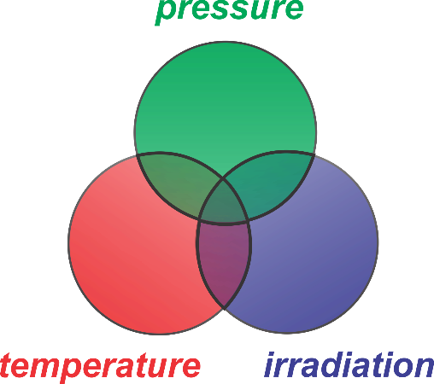
III. MULTIPLE EXTREMES
Coupling of Multiple Extremes
Advanced Radiation Facility
High-Pressure Cell P ~ 1 Mbar
Intense
Laser Pulses
40 J/cm²
from: www.simsworkshop.org
Ion Irradiation ρ_{E} ~ eV/atom
from: www.sunbeamtech.com
7

Slide 8
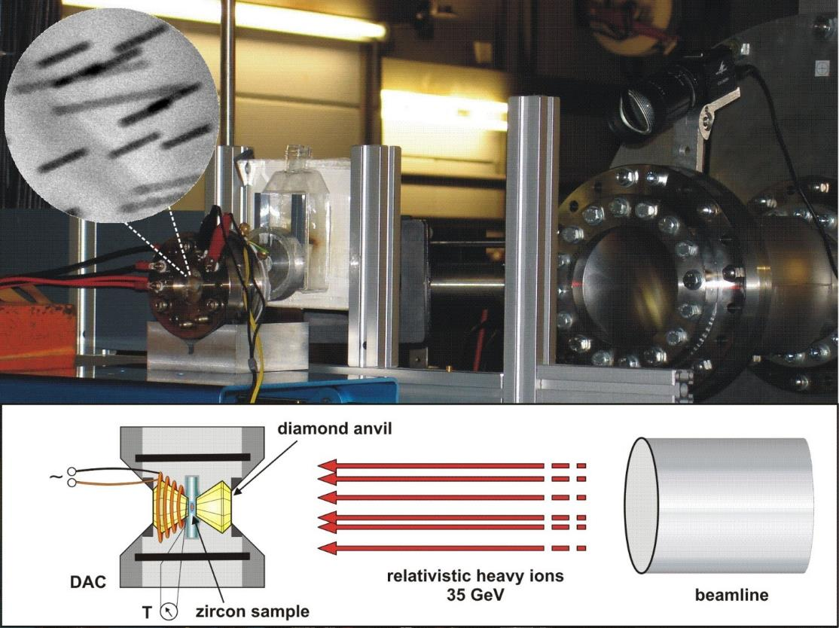
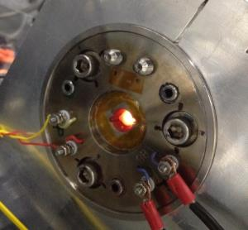
III. MULTIPLE EXTREMES
Coupling of Multiple Extremes
Advanced Radiation Facility
M. Lang, et al., Synchrotron Radiation. (2009)
High-Pressure Irradiations
Relativistic heavy ions penetrate one diamond anvil of DAC (~2 mm)
Sample is exposed to high pressure (and high-T) when being irradiated
Successfully applied to 1 Mbar and 10¹³ ions/cm²
8

Slide 9
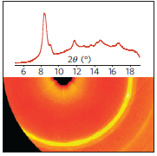
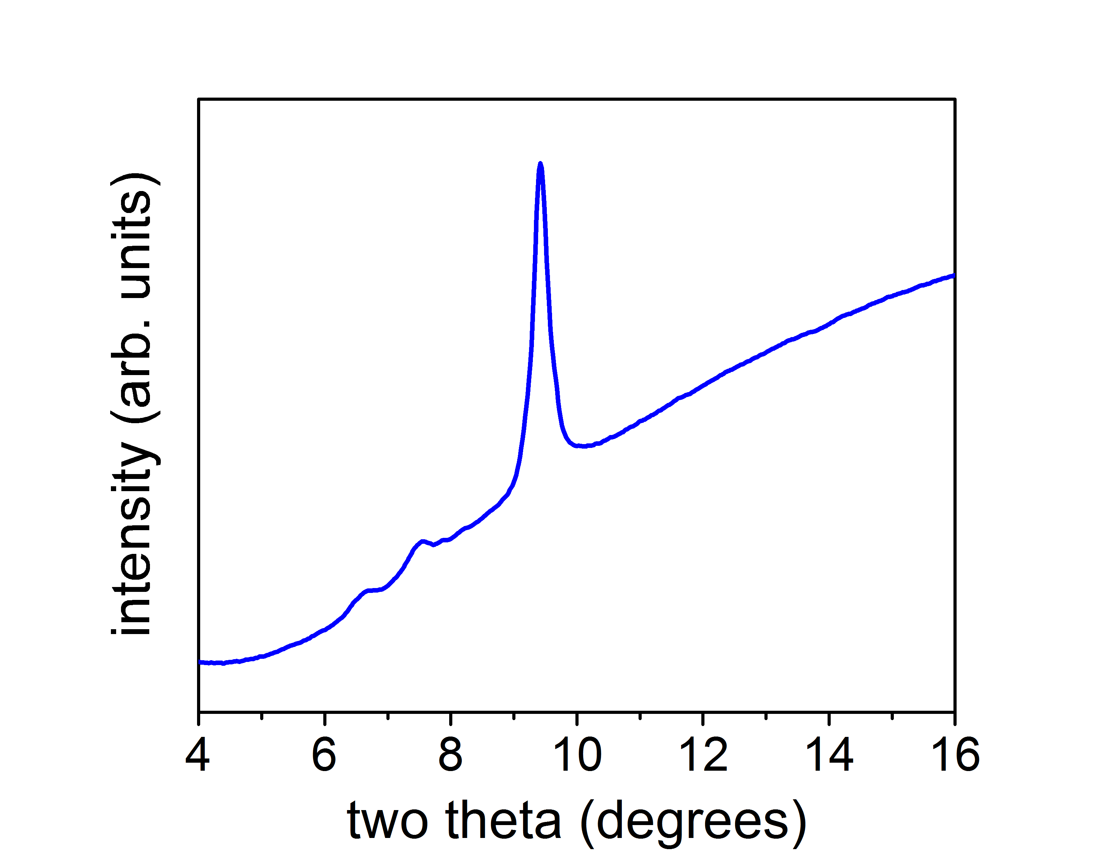
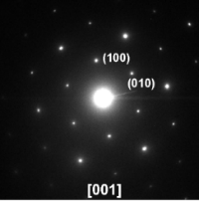

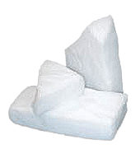



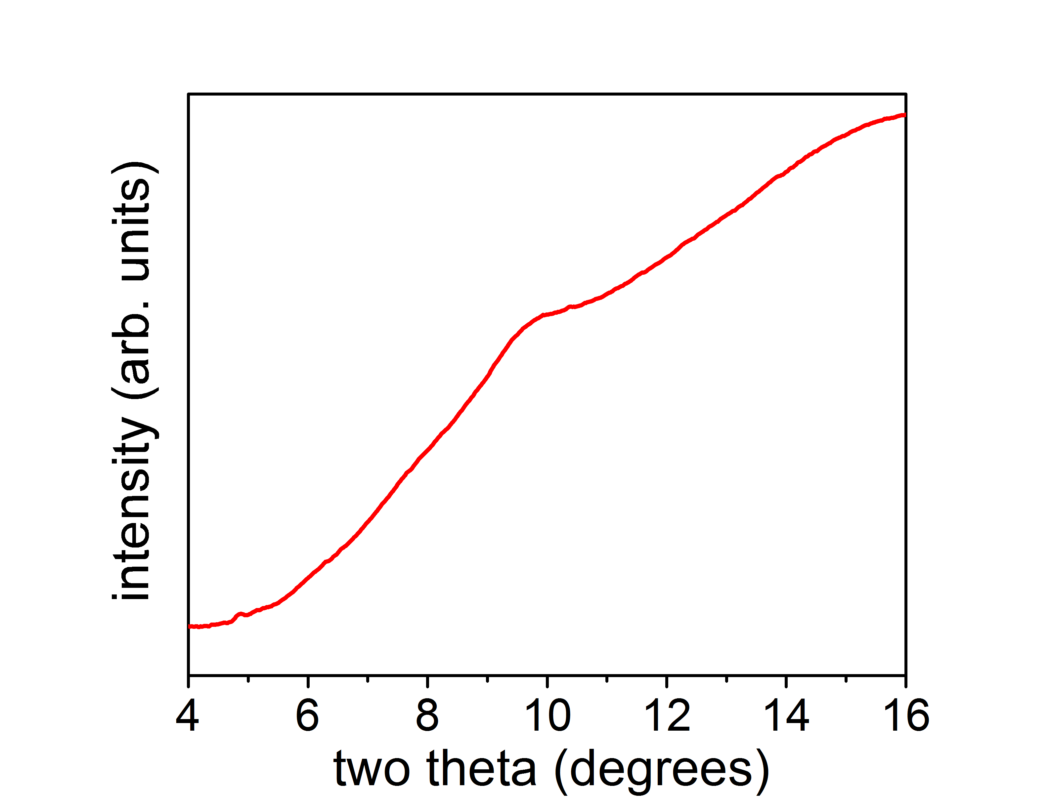
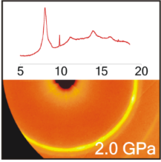
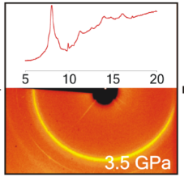
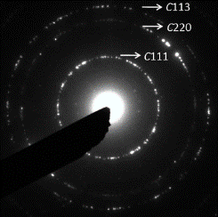
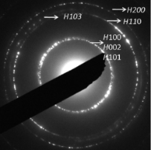


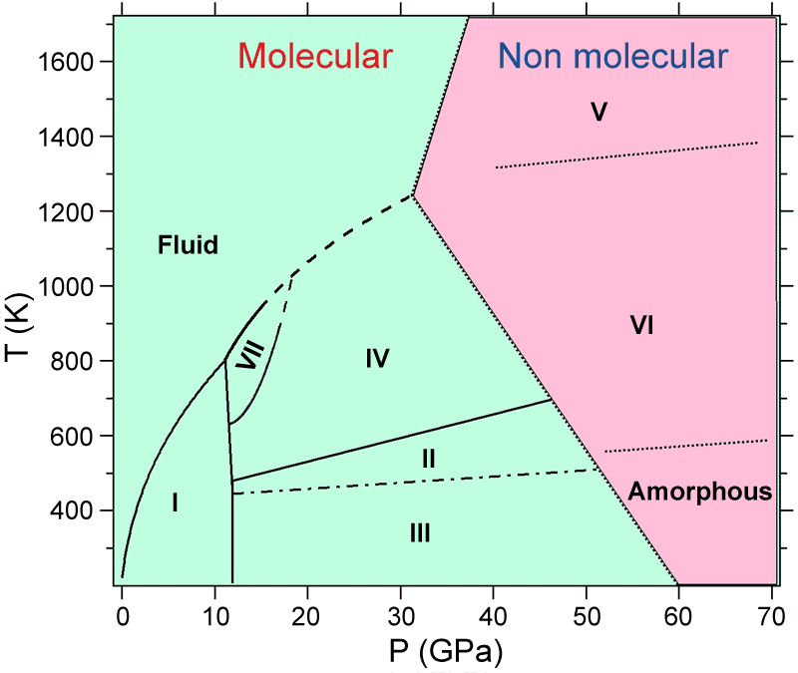
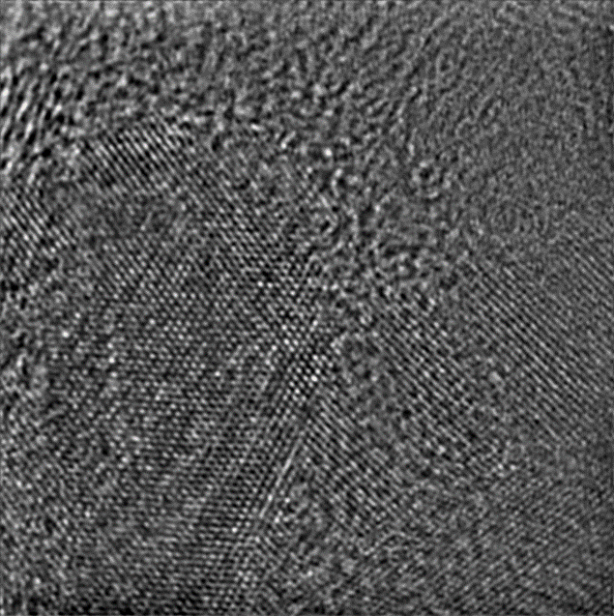
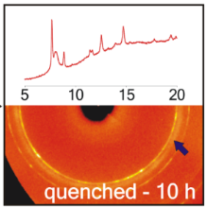
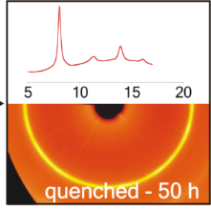

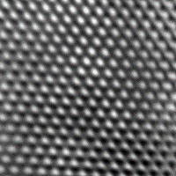
Material Behavior under Coupled Extremes
III. MULTIPLE EXTREMES
Advanced Radiation Facility
I. Phase Stabilization
Gd₂Zr₂O₇ + 21.5 GPa + 20 GeV Xe ions
II. Phase Transformation
Graphite + 47 GPa + 6 GeV U ions
III. Exotic Molecular Solids
CO₂ + 45 GPa + 6 GeV Au ions
cotunnite
21.5 GPa
graphite
Ice-III
amorphous
X-Phase
X-Phase
X-Phase
cubic diamond
hex. diamond
fluorite
J.M. Hirtz, et al., in preparation
M. Lang, et al., Nature Materials (2009)
unpublished data
9

Slide 10
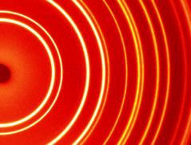
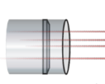

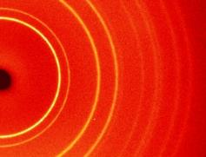
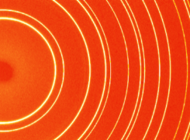

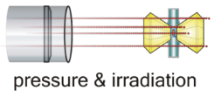




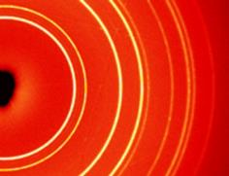

Subsequent vs. Simultaneous Coupled Extremes
III. MULTIPLE EXTREMES
Advanced Radiation Facility
Subsequent Coupling of Extremes
CeO₂ + 35 GPa + 1.7 GeV ¹⁹⁷Au ions
defective (cubic)
Simultaneous Coupling of Extremes
CeO₂ + 20 GPa + 7 GeV ²³⁸U ions
Φ
CeO₂
Φ
+
P
Φ + P
defective (cubic)
undamaged (cubic)
high-P phase (orthorhombic)
P
defective (cubic)
11

Slide 11
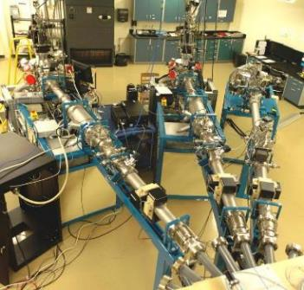
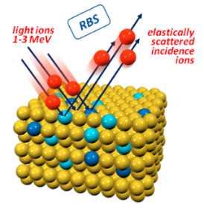
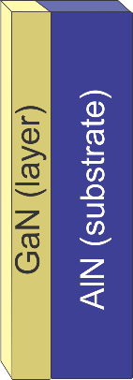
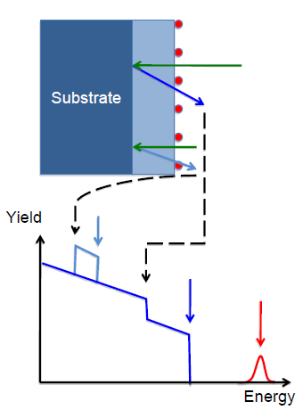
Synergistic Effects of Coupled Extremes
III. MULTIPLE EXTREMES
Advanced Radiation Facility
Rutherford Backscattering (RBS)
Unique tool for defect analysis
Depth dependent and highly sensitive
Ideal for surface and near surface damage
RBS/C @ TIBML
irradiated GaN
pristine GaN
10

Slide 12
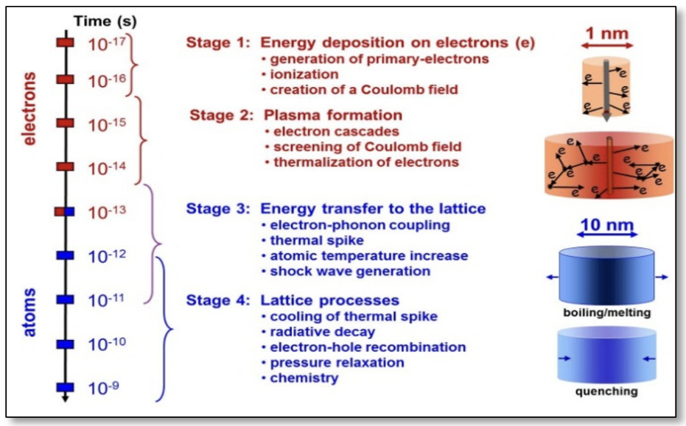
Modeling Swift, Heavy Ion Irradiation Effects
III. MULTIPLE EXTREMES
Advanced Radiation Facility
Computational challenge: ion-matter interactions
Span ~15 orders of magnitude in time (femtoseconds to seconds) and ~8 orders of manitude in length (Angstrom to mm)
Involves electronic and atomic degrees of freedom that are deeply coupled
Experiment captures the final state while computation has to reconstruct the pathway
946 MeV ¹⁹⁷Au ions
11

Slide 13
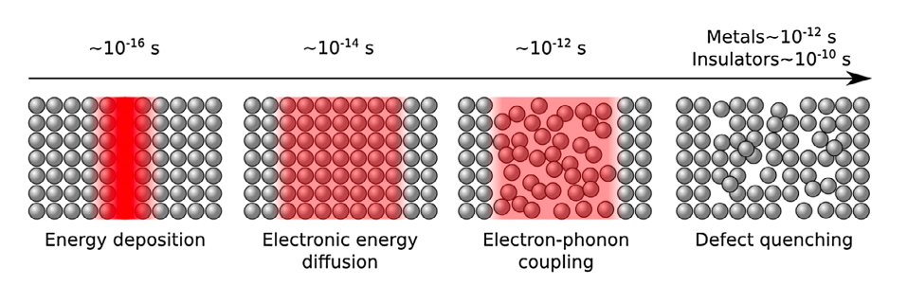
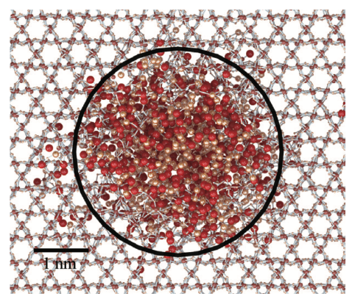
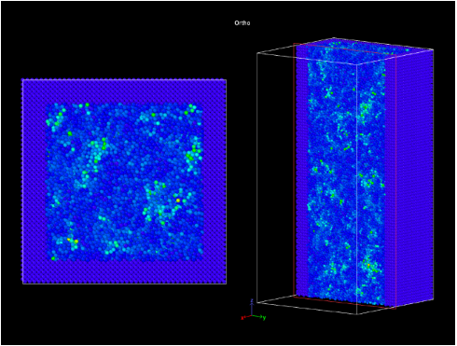
Molecular Dynamics Approach to SHI Irradiation
III. MULTIPLE EXTREMES
Advanced Radiation Facility
Bridging electronic energy deposition to atomic dynamics
SHI deposit enormous energy densities `10s of keV/nm via dense electronic excitation and ionization; classical MD alone insufficient
Electronic energy coupled to atomic dynamics via electron-phonon coupling, Langevin thermostat, and empirical dose distributions
Model system: CeO2 where redox effects play a unique role in defect distribution strain evolution, and phase transformation behavior
A first comprehensive handshake between computation/experiment
Electronic energy deposition to lattice via two-temp molecular dynamics (Darkins et al. 2018)
SiO₂ – Leino et al. (2015)
CeO₂ - G. Clopton (ongoing)
11
Notes:
Swift heavy ions deposit enormous energy densities (tens of keV/nm) via dense electronic excitation and ionization — classical MD alone cannot capture this Electronic energy coupled to atomic dynamics via: electron-phonon coupling, Langevin thermostat, and empirical dose distributions — approaches validated in UO2, Al2O3, SiC, and pyrochlore CeO2 as model system: redox effects play a unique role in defect distribution, strain evolution, and phase transformation behavior Simulations validated against Lang's experimental benchmark datasets (XANES quantification of redox changes, single ion track characterization) Grain size as a key variable: nano-grained samples show enhanced redox effects, with hypothesized amorphization below 5 nm grain size Deliverable: quantitative, experimentally validated model of ion track formation — portable to other ceramics, metals, and amorphous materials
By contrast, the source term for SHI irradiation (Fig. 2b) is often
assumed to have a two-dimensional Gaussian spatial variation
(width r) and an exponentially decaying time variation (decay
time s)

Slide 14
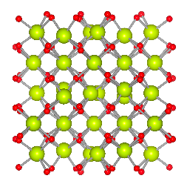
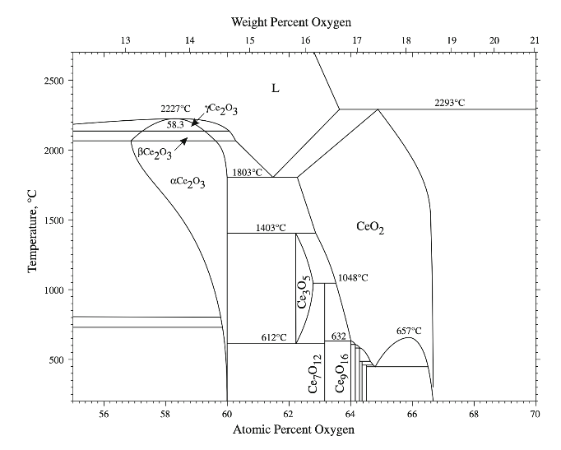
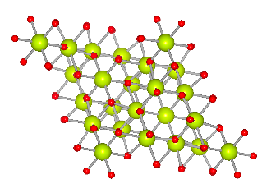
Defect Structures and Phase Diagrams
III. MULTIPLE EXTREMES
Advanced Radiation Facility
From track formation to equilibrium and
metastable defect landscapes
Molecular dynamics simulations predict the full diversity of defect structures across irradiation conditions: energy density (dE/dx), grain size, pre-existing damage, and dopant concentration
Defect zoo in irradiated CeO₂: Frenkel/Schottky pairs, point defect clusters, dislocation cores, stacking faults, twin boundaries
Core/shell track morphology: intense plasma-condition core+dilute outer halo; grain size controls competition between oxygen expulsion and grain boundary trapping
Defect phase diagrams in P-T-m space: map equilibrium and metastable defect phases, identify how coupled extremes shift stability boundaries
Ce₂O₃
Ia3
Ce₇O₁₂
R3
11
Notes:
MD simulations predict the full diversity of defect structures arising across irradiation conditions: energy density (E, dE/dx), grain size, pre-existing damage, and dopant concentration Defect zoo in irradiated CeO2: redox-induced Frenkel/Schottky pairs, point defect clusters, dislocation cores, stacking faults, twin boundaries — and their spatial distributions within and around tracks Core/shell track morphology: inner plasma-condition core with intense damage, outer halo of dilute defects — grain size controls the competition between outward oxygen expulsion and grain boundary trapping Rare earth doping (Sm, Gd, Nd): varying electron/hole concentrations modify the electron-mediated energy transfer, changing defect distributions — experiment and simulation jointly quantify this Defect phase diagrams constructed in P-T-μ space: equilibrium and metastable defect phases, how coupled extremes shift stability boundaries and enable access to otherwise inaccessible defect configurations Framework validated in CeO2, then extended to c-BN, WC, ZrC, ZrN

Slide 15
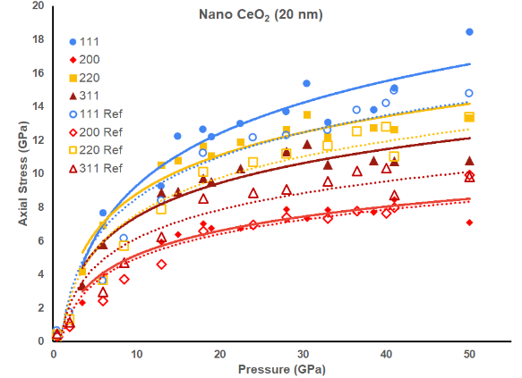
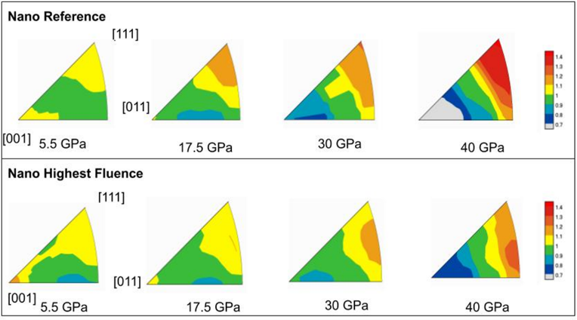
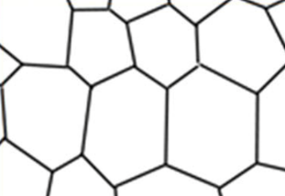


From Defects to Mechanical Properties
III. MULTIPLE EXTREMES
Advanced Radiation Facility
SHI effect on strength and texture of CeO₂. Courtesy: Lowell Miyagi.
grain size effects
Closing the loop from atomic-scale damage to macroscopic behavior
MD defect configurations $→$ predictions of elastic moduli, yield strength, deformation mechanisms
Ex: irradiated CeO2 exhibits a 30% strength increase; MD provides the atomistic explanation
Deformation maps across P-T to ~100 Gpa, 2000 K and strain rates (10-6 yo 102 s-1)
Framework extended across oxides, carbides. Further: nitrides, amorphous materials, metals ad to P-H, P-E space for hidden phases
11

Slide 16
Radiation Experiments and Defect Characterization
John Hirtz, University of Tennessee, jhirtz@utk.edu
Stewardship Science
Academic Alliances
Center Review Meeting
April 15, 2026

Slide 17









Radiation Experiments using Swift Heavy Ions
III. MULTIPLE EXTREMES
Advanced Radiation Facility
FAIR – GSI Helmholtz Center (Darmstadt, Germany)
1.5 GeV Au ions
10¹³ cm⁻²
~100 mg
II. Bulk-Irradiation Experiments (Neutron Probes)
I. Microscopic Sample Irradiation Experiments (X-ray Probes)
950 MeV Au ions
10¹⁰ – 10¹⁴ cm⁻²
E.C. O’Quinn, et al., Nuclear Science and Engineering (2025)
(CDAC supported)
Sample chambers
diameter: 100 μm
thickness: 25 μm
M. Lang, et al., Journal of Materials Research (2015)
(CDAC supported)
17
12

Slide 18












Defect Characterization at Large User Facilities
III. MULTIPLE EXTREMES
Advanced Radiation Facility
X-Ray Analysis at HPCAT
Neutron Total Scattering at NOMAD
Fourier
transform
analysis of large fluence series using 3D-printed customized holder (~1 µg per sample)
coupled diffraction (XRD) and spectroscopy (EXAFS) measurements
swelling, strain/grain size, and oxidation state
developed high-throughput measurement approach, including for actinide materials
neutron diffraction & pair distribution function (PDF) analysis
short- & long-range structural information (cations + anions)
developing PDF analysis at SNAP: (i) short-range order at high-P (ii) analysis of irradiated samples with reduced mass (~5 mg)
13

Slide 19





Defect Formation in Simple Oxide Fluorites
III. MULTIPLE EXTREMES
Advanced Radiation Facility
XRD
Redox changes induced by ionizing radiation
⇨ partial reduction of Ce⁴⁺ to Ce³⁺
determines radiation response
d = 5.8 ± 0.6 nm
d = 6.1 ± 0.1 nm
950 MeV Au ions
XAS
Ce K-edge
$$\frac{∆a}{a_{0}}=\frac{a\left(φ\right)−a_{0}}{a_{0}}=\frac{a_{sat}−a_{0}}{a_{0}}\left(1−e^{−σφ}\right)$$
C.L. Tracy, et al., Nature Communications 6, 6133 (2015)
(CDAC-supported beamtime)
14

Slide 20





Short-Range Defect Structure in Irradiated Ceria
III. MULTIPLE EXTREMES
Advanced Radiation Facility
Neutron total scattering and PDF analysis
1.5 GeV Au ions
CeO₂
p
e
r
o
x
i
d
e
d
e
f
e
c
t
f
o
r
m
a
t
i
o
n
i
n
C
e
O
2
[
O
—
O
]
2
-
(
o
x
y
g
e
n
-
o
x
y
g
e
n
d
i
s
t
a
n
c
e
~
1
.
4
5
Å
)
⇨ peroxide-type O₂ clusters formed as counterpart to reduction process (Ce⁴⁺ to Ce³⁺ )
R.I. Palomares, et al., J. Mater. Chem. A (2017)
(CDAC supported)
16

Slide 21

Short-Range Defect Structure in Oxidized Urania
III. MULTIPLE EXTREMES
Advanced Radiation Facility
UO₂ → UO_{2+x}
W.F. Cureton, et al., Inorganic Chemistry (2025)
(CDAC supported)
7

Slide 22



Defect Formation in Oxides versus Carbides
III. MULTIPLE EXTREMES
Advanced Radiation Facility
d = 3 nm
UC
Actinide Compounds
UC
CeO₂
950 MeV Au
UO₂
UO₂
ZrC
d = 5 nm
Oxidation Behavior
ZrO₂
⇨ direct-impact process for CeO₂
⇨ two-step mechanism for ZrC
pristine
irradiated
⇨ less swelling for UO₂
⇨ track size UO₂ > UC
ZrC
J. Minnette, et al., Journal of Applied Physics (2023)
(CDAC supported)
D. Chaney, et al., Journal of Materials Science (2023)
(CDAC supported)
⇨ oxidation dramatically
in irradiated ZrC
17

Slide 23
Machine Learned Interatomic Potentials for SHI Irradiation of CeO₂
Grady Clopton, University of Illinois Urbana-Champaign, gclopton@illinois.edu
Stewardship Science
Academic Alliances
Center Review Meeting
April 15, 2026

Slide 24


Classical MD Results
SHI Track simulations in LAMMPS with classical rigid-ion Buckingham + Coulomb potential
Simulations captured thermal disorder, point defects, and local rearrangements; did not reproduce the chemically realistic track response suggested by experiment
Core Limitation: fixed-charge classical potentials cannot represent Ce(4+) → Ce(3+) reduction.
Oxygen vacancy formation in real ceria leaves two electrons that localize on nearby Ce sites; this changes local bonding, defect energetics, migration barriers, strain, and recovery behavior.

Slide 25

MLIP Generation
MLIP trained on first-principles energies and forces
The MLIP learns not just distances, but the geometry of the local coordination environment.
makes large-scale TTM-MD in LAMMPS, practical
Training strategy: calibrate a consistent DFT+U reference, then generate labeled structures across the ceria reduction series
Train on DFT+U energies, forces, and stresses
25

Slide 26




Data Generation
Main challenge: in ceria, oxygen vacancies are coupled to Ce⁴⁺/Ce³⁺ redox changes
Training data must therefore capture both atomic distortions and the correct localized 4f electronic state
DFT+U can describe this physics, but reduced ceria often has multiple metastable 4f occupation patterns
We generate data across the ceria reduction series CeO₂, Ce₇O₁₂ Ce₂O₃.
Data Generation Process:
Use ab initio molecular dynamics at multiple temperatures to sample anharmonic, non-equilibrium local environments
Label each configuration with total energies, atomic forces

Slide 27
Ab initio Modeling of Uranium Carbides and Nitrides
Amir O. Movaffagh, University of Illinois Chicago, aorvat2@uic.edu
Stewardship Science
Academic Alliances
Center Review Meeting
April 15, 2026

Slide 28












Actinide Ceramics for Advanced Reactor Fuel Applications
III. MULTIPLE EXTREMES
Targeted Materials
Carbothermic Reduction
Reaction
MOTIVATION
Synthesis and multi-scale characterization of UC and UN TRISO fuel kernels for application in accident tolerant fuel (ATF) systems via sol–gel internal gelation
UO₃
SIGNIFICANCE
Multiple rocksalt UN (UCN) phases identirfied, enabled by high-resolution XRD/neutron scattering
Improved control of phase composition in UC/UN TRISO fuel kernels through synthesis–structure relationships
Scalable production of uniform TRISO fuel kernels with controlled microstructure
Jacob Minnette
Amir M. Orvati Movaffagh
UC
UN

Slide 29

Actinide Ceramics for Advanced Reactor Fuel Applications
III. MULTIPLE EXTREMES
Targeted Materials
Challenges:
Anion-site composition: identification of species occupying N-sites
Multiple rocksalt phases: Underlying mechanisms behind the formation of UN-1 and UN-2
Oxidation behavior: Relative stability and reaction pathways of UC vs. UC₂ and UN vs. U₂N₃
Jacob Minnette
Amir M. Orvati Movaffagh
Refinement parameter | X-ray | Neutron
Rocksalt (UN-1) [wt. %] | 67.4 ± 0.6 | 69.6 ± 0.7 *
Rocksalt (UN-2) [wt. %] | 28.5 ± 0.6 | 25.8 ± 0.7 *

Slide 30








Actinide Ceramics for Advanced Reactor Fuel Applications
III. MULTIPLE EXTREMES
Targeted Materials
+0.43%
+0.25%
+0.10%
+0.46%
+0.25%
-0.65%
At 50%:
SQS - VCA ≈ 0.2%
≈ 99.5% Accuracy
+0.69%
+0.25%
+0.63%
Jacob Minnette
Amir M. Orvati Movaffagh
+0.69%
+0.22%
+0.35%
-0.16%
+0.22%
+0.35%
Results so far:
SQS reproduces UCP with ~99.5% accuracy
UCP curvature explained: Attributed to carbon incorporation on N-sites and local chemical environment effects, not captured by VCA
VCA
SQS

Slide 31
DEF Approach for Defect Phase Diagrams for SHI
Sara Kadkhodaei, Ph.D.
Associate Professor,
University of Illinois Chicago, sarakad@uic.edu
Stewardship Science
Academic Alliances
Center Review Meeting
April 15, 2026

Slide 32





Ab initio Modeling of Defects
III. MULTIPLE EXTREMES
Experiment and Theory
I. DFT calculations of defects in ceria
$$Formation Energy=E_{defect} −E_{bulk} −∑ΔN_{i}μ_{i}+qE_{F}$$
II. Defect energies in UC
LIMITATION
Chemical potential (μ)- and Fermi level (Ε_{F})- dependent defect energetics
Defects are typically treated individually, without a unified description of their collective distribution in defective phases
Ertekin’s group (ongoing)
32
Huang, J. Phys. Chem. C, 2010| Zacherle, Phys. Rev. B. 2013 |Tiwary, Phys. Rev. B. 2009| Ducher, Phys. Rev. B. 2011

Slide 33


CALPHAD Modeling of Defects
III. MULTIPLE EXTREMES
Experiment and Theory
LIMITATION
Phase diagrams often rely on fitting thermochemical data
Built from heat capacities and measured phase boundaries
Data-dependent and non-universal, limited physical grounding
Phase-boundary data are hard to obtain for dilute defects
Does not identify defect types (blind to defect chemistry)
CALPHAD
Phase diagram of Ce-O around CeO₂
Lian Cheng Wang, (2018)
ADVANTAGE
Environment-independent Gibbs energy (G) parameterization
Chemical and electronic coexistence conditions come directly from CALPHAD
No separate deduction needed for varying T, X, and P.
Matvei Zinkevich, et al., Solid State Ionics 177 (2006)
33

Slide 34






Defect Energy Formalism (DEF)
III. MULTIPLE EXTREMES
Experiment and Theory
MOTIVATION
Integrating ab initio defect energetics into CALPHAD Gibbs energies with predictive advantages
collective descriptions of defects in defective phases
Universal parameterization independent of μ and E_{F}
I. Physics-grounded Gibbs Energy of Defective Phases in DEF
A. Movaffagh, et al., Physical Review Materials 8 (2024)
II. Application of DEF to dilute defect thermodynamics in Mg₂Si
34
A. Movaffagh, et al., submitted to Acta Materialia (2026),

Slide 35




DEF Analysis of SHI Tracks and Phase Tolerance in Ceria
III. MULTIPLE EXTREMES
Experiment and Theory
MOTIVATION
Investigate irradiation-induced defects in CeO₂ and the resulting microstructural and phase changes
I. Neutron total scattering and PDF
II. Two-temperature MD simulation of ion irradiation in ceria
APPROACH
A combined theoretical, modeling, and experimental approach
Intense ion irradiation at a large accelerator facility (Lang, UTK)
Ab initio/MLIP molecular dynamics simulation (Ertekin, UIUC)
DEF analysis of defective phases (Kadkhodaei, UIC)
Ertekin’s group (ongoing)
⇨ peroxide-type O2 clusters formed as counter part to reduction process (Ce⁴⁺ to Ce³⁺ )
R.I. Palomares, et al., J. Mater. Chem. A (2017)
DEF for Modeling
Incorporating defect complexes (e.g., peroxide-type dimer, oxygen Frenkel pairs)
Ordering of oxygen vacancies can produce locally ordered fluorite-derivative superstructures that break from long-range fluorite symmetry
Maik Lang
Elif Ertekin
Sara Kadkhodaei
Notes:
The goal of this collaborative research is to investigate the behavior of radiation defects in ceria using a combined theoretical, computational, machine-learning, and experimental framework.
Top figure: an example of an irradiation ion track in ceria
Bottom figure: a snapshot of two-temperature MD simulation of ion irradiation in ceria (Ertekin’s group)
- Right figure: an example of a CALPHAD-based phase diagram of Ce-O, illustrating non-stoichiometric ceria (fluorite phase) and several locally ordered fluorite-derivative superstructures

Slide 36

Impact of Defect Structure on
Material Behavior at Extremes
Lowell Miyagi, Ph.D.
Professor,
University of Utah, lowell.miyagi@utah.edu
Stewardship Science
Academic Alliances
Center Review Meeting
April 15, 2026

Slide 37













Impact of Defect Structure on Materials Behavior Under Extremes
Chantelle Kiessner
Blake Sturtevant
LANL
Lowell Miyagi
Maik Lang
J. Hirtz (UTK), R. Hrubiak (HP-CAT), and A. Berlin (UU)
Sector 16-ID-B
Elif Ertekin
Steve Jacobsen

Slide 38



Radial Diffraction
Crystal lattice strain (elastic)
Calculate stresses
Strength of materials
Texture / preferred orientation (plastic)
Deformation mechanisms (slip systems, twinning)
Transformation mechanisms

Slide 39











Polycrystal Plasticity Modeling → Deformation Mechanisms
Visco-plastic self consistent code (Lebensohn and Tome 1993)
VPSC models
Self consistent modeling
b
EVPSC
(Wang et al 2010)
Applied to
high pressure
(Lin et al., 2017)
a
Elasto-plastic self consistent code (Turner and Tome 1993; Merkel et al 2009)
Carlos Tomé
Ricardo Lebensohn

Slide 40



Deformation of CeO₂ Cerianite (Huston et al., 2022)
Experiment
EVPSC
Pratt et al 1966 - fluorite primary slip system is {100}<110>
FCC metals – slip on {111}<1-10>
Notes:
Note {100}<110> also gives a 011 texture but the Q don’t fit

Slide 41





Deformation of Irradiated CeO₂ Cerianite (200 MeV Xe )
{110}<1-11>
{112}<111> twinning
Notes:
Shear modulus from Sun et al., 2010

Slide 42







Impact of Defect Structure on Materials Behavior Under Extremes
Radiation damage in nano and micro CeO₂
Grain size reduction increases strength
Grain size reduction changes deformation mechanisms (increased twinning)
Irradiated samples are stronger
Radiation damage changes deformation mechanisms (suppresses twinning)
Mechanism of strengthening in irradiated samples is distinct from grain size reduction
What about other materials?
CDAC student A. Berlin.
WC irradiated with 946 MeV 197Au ions.
Future work:
Defect modeling materials (Ertikin)
Elasticity measurements (Jacobsen).
Kiessner et al., in prep
Berlin in prep

Slide 43

Influence of Defect Structure on Elastic Response
Influence of Defect Structure on Elastic Response
Steven Jacobsen, Ph.D.
Professor,
University of Colorado, Boulder, steven.jacobsen@colorado.edu
Stewardship Science
Academic Alliances
Center Review Meeting
April 15, 2026

Slide 44






GHz-ultrasonics: a unique capability of the Center
I. MULTIPLE EXTREMES
Future Directions
MOTIVATION
Measure high-precision acoustic velocities in samples that are too small or opaque for conventional methods (MHz-ultrasonics, Brillouin): Irradiated samples and deformation experiments
P-to-S conversion
100μm diameter probe
APPROACH
In conjunction with sample-length interferometry, we can use GHz P-wave and S-wave measurements to determine highly accurate elastic constants in sub-mm crystals, glasses, and nanopolycrystalline materials.
Developed thin-film ZnO transducers to produce acoustic waves with near-optical wavelength at 1-2 GHz

Slide 45








GHz-ultrasonics: a unique capability of the Center
I. MULTIPLE EXTREMES
Future Directions
Opaque Crystals
Amorphous Materials
Superhard Materials
Anomalous compression of v-SiO₂
Molecular Crystals
Acetaminophen
(RDX analog) elastic tensor
Liu et al. (2017) Sci Rep 7:42921
Clark et al. (2014) PRB 90:174110
FUTURE DIRECTION
Nanocrystalline Materials
NPD
CDAC Partners Jacobsen (CU Boulder), Lowell Miyagi (Utah) and Maik Lang (Tennessee) plan to collaborate on using GHz-ultrasonics to determine the ambient shear modulus for dynamic-DAC data interpretation, deformation experiments, and irradiated samples
In collaboration with K. Ramos and C. Bolme, LANL (work in prep)
Jacobsen et al. (2004) PNAS 101:5867
(note: this study shown because it informs the current ZFSP project)
Chang et al. (2014) PEPI 228:47

Slide 46
Thrust 3
Multiple Extremes: Technique Development; Next Steps
Maik Lang, University of Tennessee, mlang2@utk.edu
Elif Ertekin, University of Illinois Urbana-Champaign, ertekin@illinois.edu
Stewardship Science
Academic Alliances
Center Review Meeting
April 15, 2026

Slide 47








Advanced Approach to Couple Extremes
III. MULTIPLE EXTREMES
Advanced Radiation Facility
2 mm
45 GPa
7 GeV ²³⁸U ions
CO₂
I. Tzifas et al., Physical Review research (2026)
(CDAC supported)
IR
Raman
Synchrotron XRD: amorphization of ice III
Molecular amorphous CO₂ phase?
Synchrotron-IR measurements of CO₂
7

Slide 48



Coupling High-Pressure with Displacive Damage
III. MULTIPLE EXTREMES
Advanced Radiation Facility
MOTIVATION
Simulate defective microstructure from self-decay of actinides and test impact on high-pressure and high-temperature behavior
APPROACH
Need low-energy accelerator facility
Determine dose level profile and optimize displacive damage within microscopic sample
Perform high-pressure/temperature experiments after ion-beam exposure at HPCAT
Correlate experimental results with model predictions
Significance
First assessment of how defects and a damaged microstructure affect material behavior under extremes
Refinement and expansion of existing equilibrium phase diagrams that are only based on pristine materials
Important data to predict impact of actinide delf-decay on phase stability and behavior under extremes
Insight whether defect engineering can be used to enhance materials resistance under extremes
Essential training opportunity for students in key field
7

Slide 49





Developing Neutron Scattering for Small Samples
III. MULTIPLE EXTREMES
Advanced Radiation Facility
X-Rays Neutrons
MOTIVATION
Enable neutron total scattering and PDF analysis for small sample quantities to (i) obtain short-range order information with sensitivity to both cations and anions, and (ii) enable high-throughput studies of irradiated materials
950 MeV Au ions
10¹⁰ – 10¹⁴ cm⁻²
1.5 GeV Au ions
10¹³ cm⁻²
Sample chambers
diameter: 100 μm
thickness: 25 μm
mass: ~1 µg
Sample chambers
diameter: 9 x 1 cm
thickness: 25 μm
mass: ~100 mg
APPROACH
Utilize existing SNAP facility at SNS currently utilized only for diffraction experiments (focused neutron beam)
Develop background removal procedures to obtain useable total scattering data
Test applicability to diamond anvil cells, capillaries, and microscopic ion-beam sample holders
irradiated - ambient
A₂B₂O₇
E.C. O’Quinn, et al., Nuclear Science and Engineering (2025)
(CDAC supported)
Significance
Significant enhancement of advanced structural characterization of ion irradiated materials
Sample minimization allows measurement of highly radioactive materials
Short-range order accessible for high-pressure studies to better understand impact on phase transformations
pristine 6 GPa
7

Slide 50
Foundation MLIPs for Redox-Active Materials
III. MULTIPLE EXTREMES
Advanced Radiation Facility
MOTIVATION
Classical potentials cannot capture Ce³⁺/Ce⁴⁺ redox effects; accurate defect structures require charge/spin-aware MLIPs
APPROACH
Develop transferable neural network MLIP for CeO2 with explicit oxidation state
Neural network cluster expansion on GPU: long-timescale MD with spin/oxidation state degrees of freedom
Couple to two-temperature model for electron-phonon dynamics at ion-track timescales
Pretrain across compositions and damage conditions; fine-tune to specific irradiation regimes
Significance
First charge/spin-aware MLIP for redox-active ceramics validated against experimental observables
Foundation model portable to other REE-oxides and actinide systems
Prerequisite for reliable defect phase diagram construction and mechanical property prediction
Training opportunity at the intersection of ML, atomic simulation, and extreme-condition materials
11

Slide 51


Exp-Driven MLIP Refinement, AI Accelerated Sampling
III. MULTIPLE EXTREMES
Advanced Radiation Facility
MLIP parameter updates; subsequent MD
MOTIVATION
MD cannot exhaustively cover the high-dimensional coupled extreme condition space — experiment and computation must inform each other continuously
APPROACH
XANES measurements of Ce³⁺/Ce⁴⁺ redox changes as quantitative update signal for MLIP refinement
Symmetry-decomposed representations to characterize correlated disorder in MD snapshots
Surrogate models trained on validated MD snapshots for accelerated condition space sampling
Active learning prioritizes most informative (P, T, dE/dx, grain size) combinations
XANES measurements:
Quantify Ce³⁺/Ce⁴⁺
Symmetry-decomposed analysis of MD damage profiles
Significance
Quantitative, automated feedback loop between XANES data and atomistic models
Symmetry-decomposed disorder descriptors: physically interpretable, transferable across material classes
Dramatic reduction in computational cost of condition space exploration
11

Slide 52


Toward Autonomous Discovery of Hidden Phases
III. MULTIPLE EXTREMES
Advanced Radiation Facility
MOTIVATION
The coupled P-T-H-E condition space is vast — sequential human-guided exploration cannot efficiently locate hidden and metastable phases
APPROACH
Model-to-experiment: AI predictions guide irradiation experiments toward conditions most likely to yield hidden phases
Experiment-to-model: XANES and diffraction data update models continuously
One-shot damage structure generation: Feynman-Kac steering in diffusion models (early-stage work in progress)
Longer horizon: fully autonomous laboratory across P-T-H-E space
Significance
First closed-loop AI-driven discovery in coupled extreme condition space
Feynman-Kac/diffusion approach: physically grounded generative framework for disordered materials
Active learning protocol transferable to other CDAC material classes and condition combinations
Positions CDAC uniquely at the intersection of world-unique experiments and Genesis AI/ML framework
Training opportunity at the frontier of AI for materials discovery
11

